Slide 1
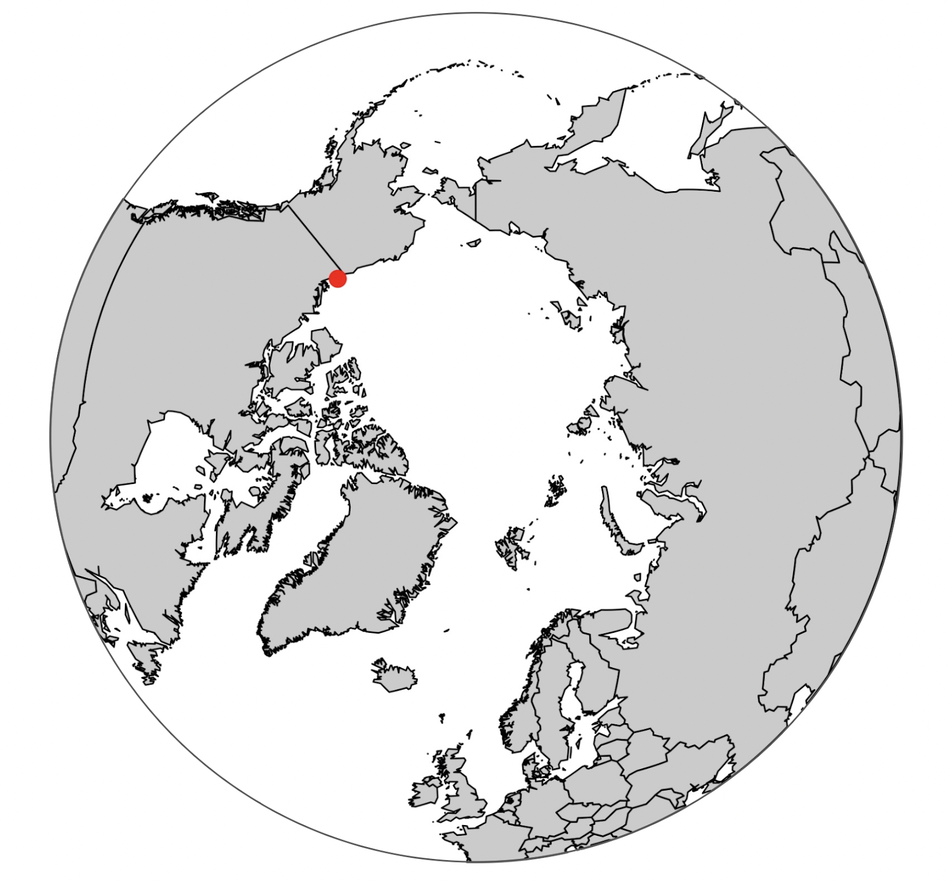
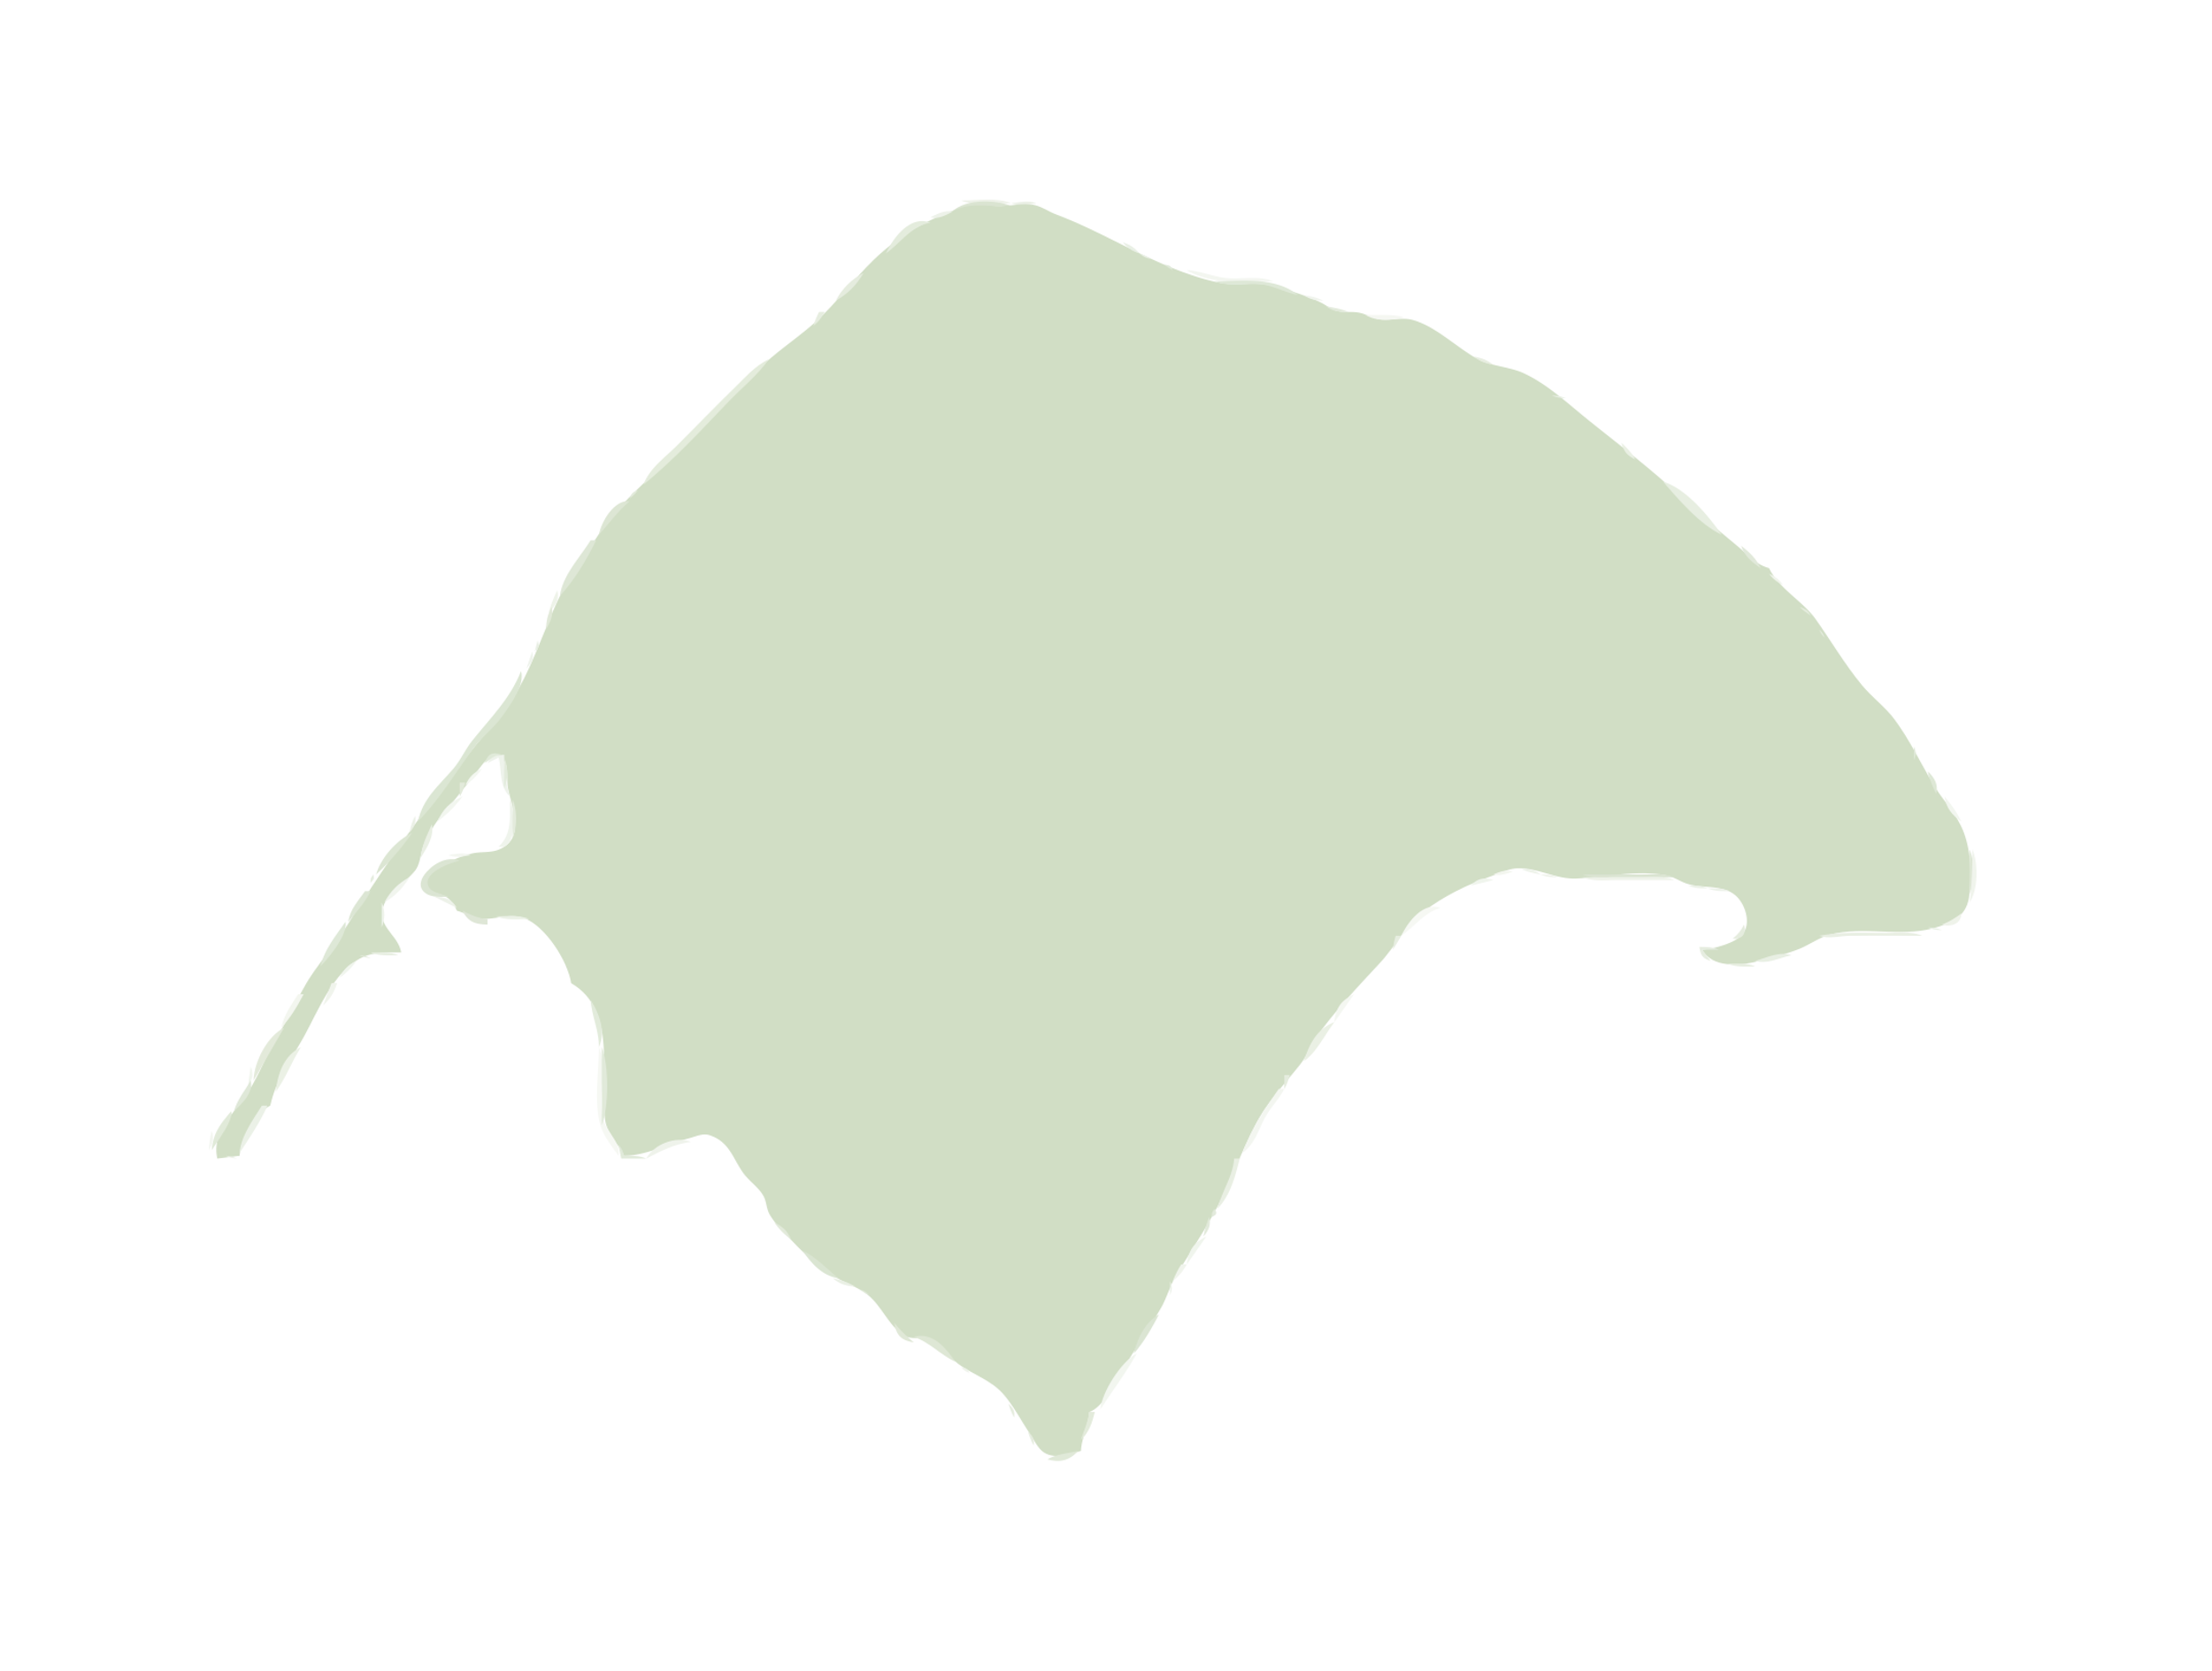
a) Location of the Qikiqtaruk-Herschel Island
b) Location of plots on the island
Komakuk
Herschel
5 km
Island icon adapted from Myers-Smith et al., 2018

Slide 2
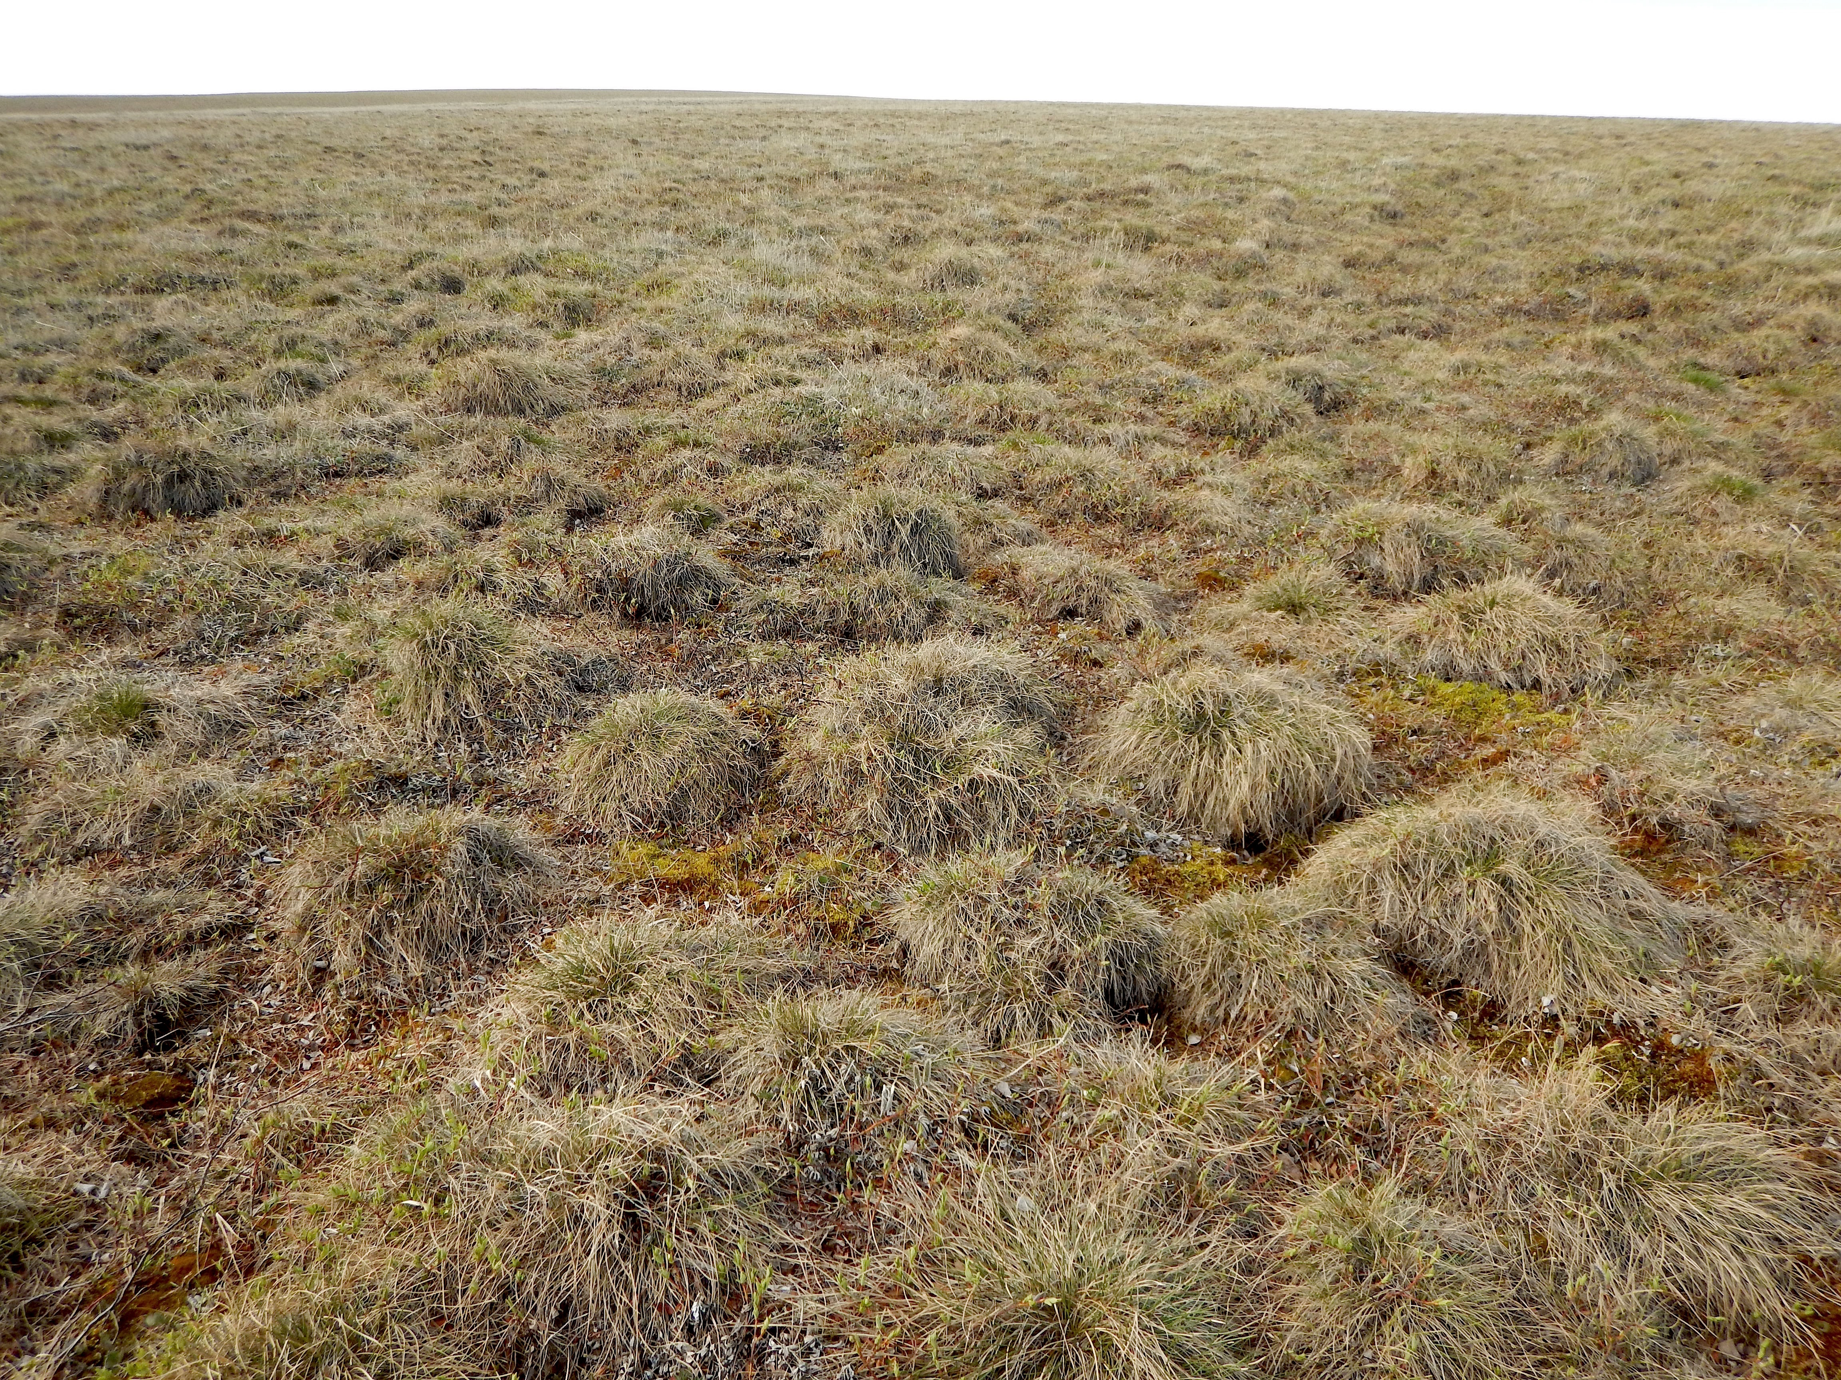
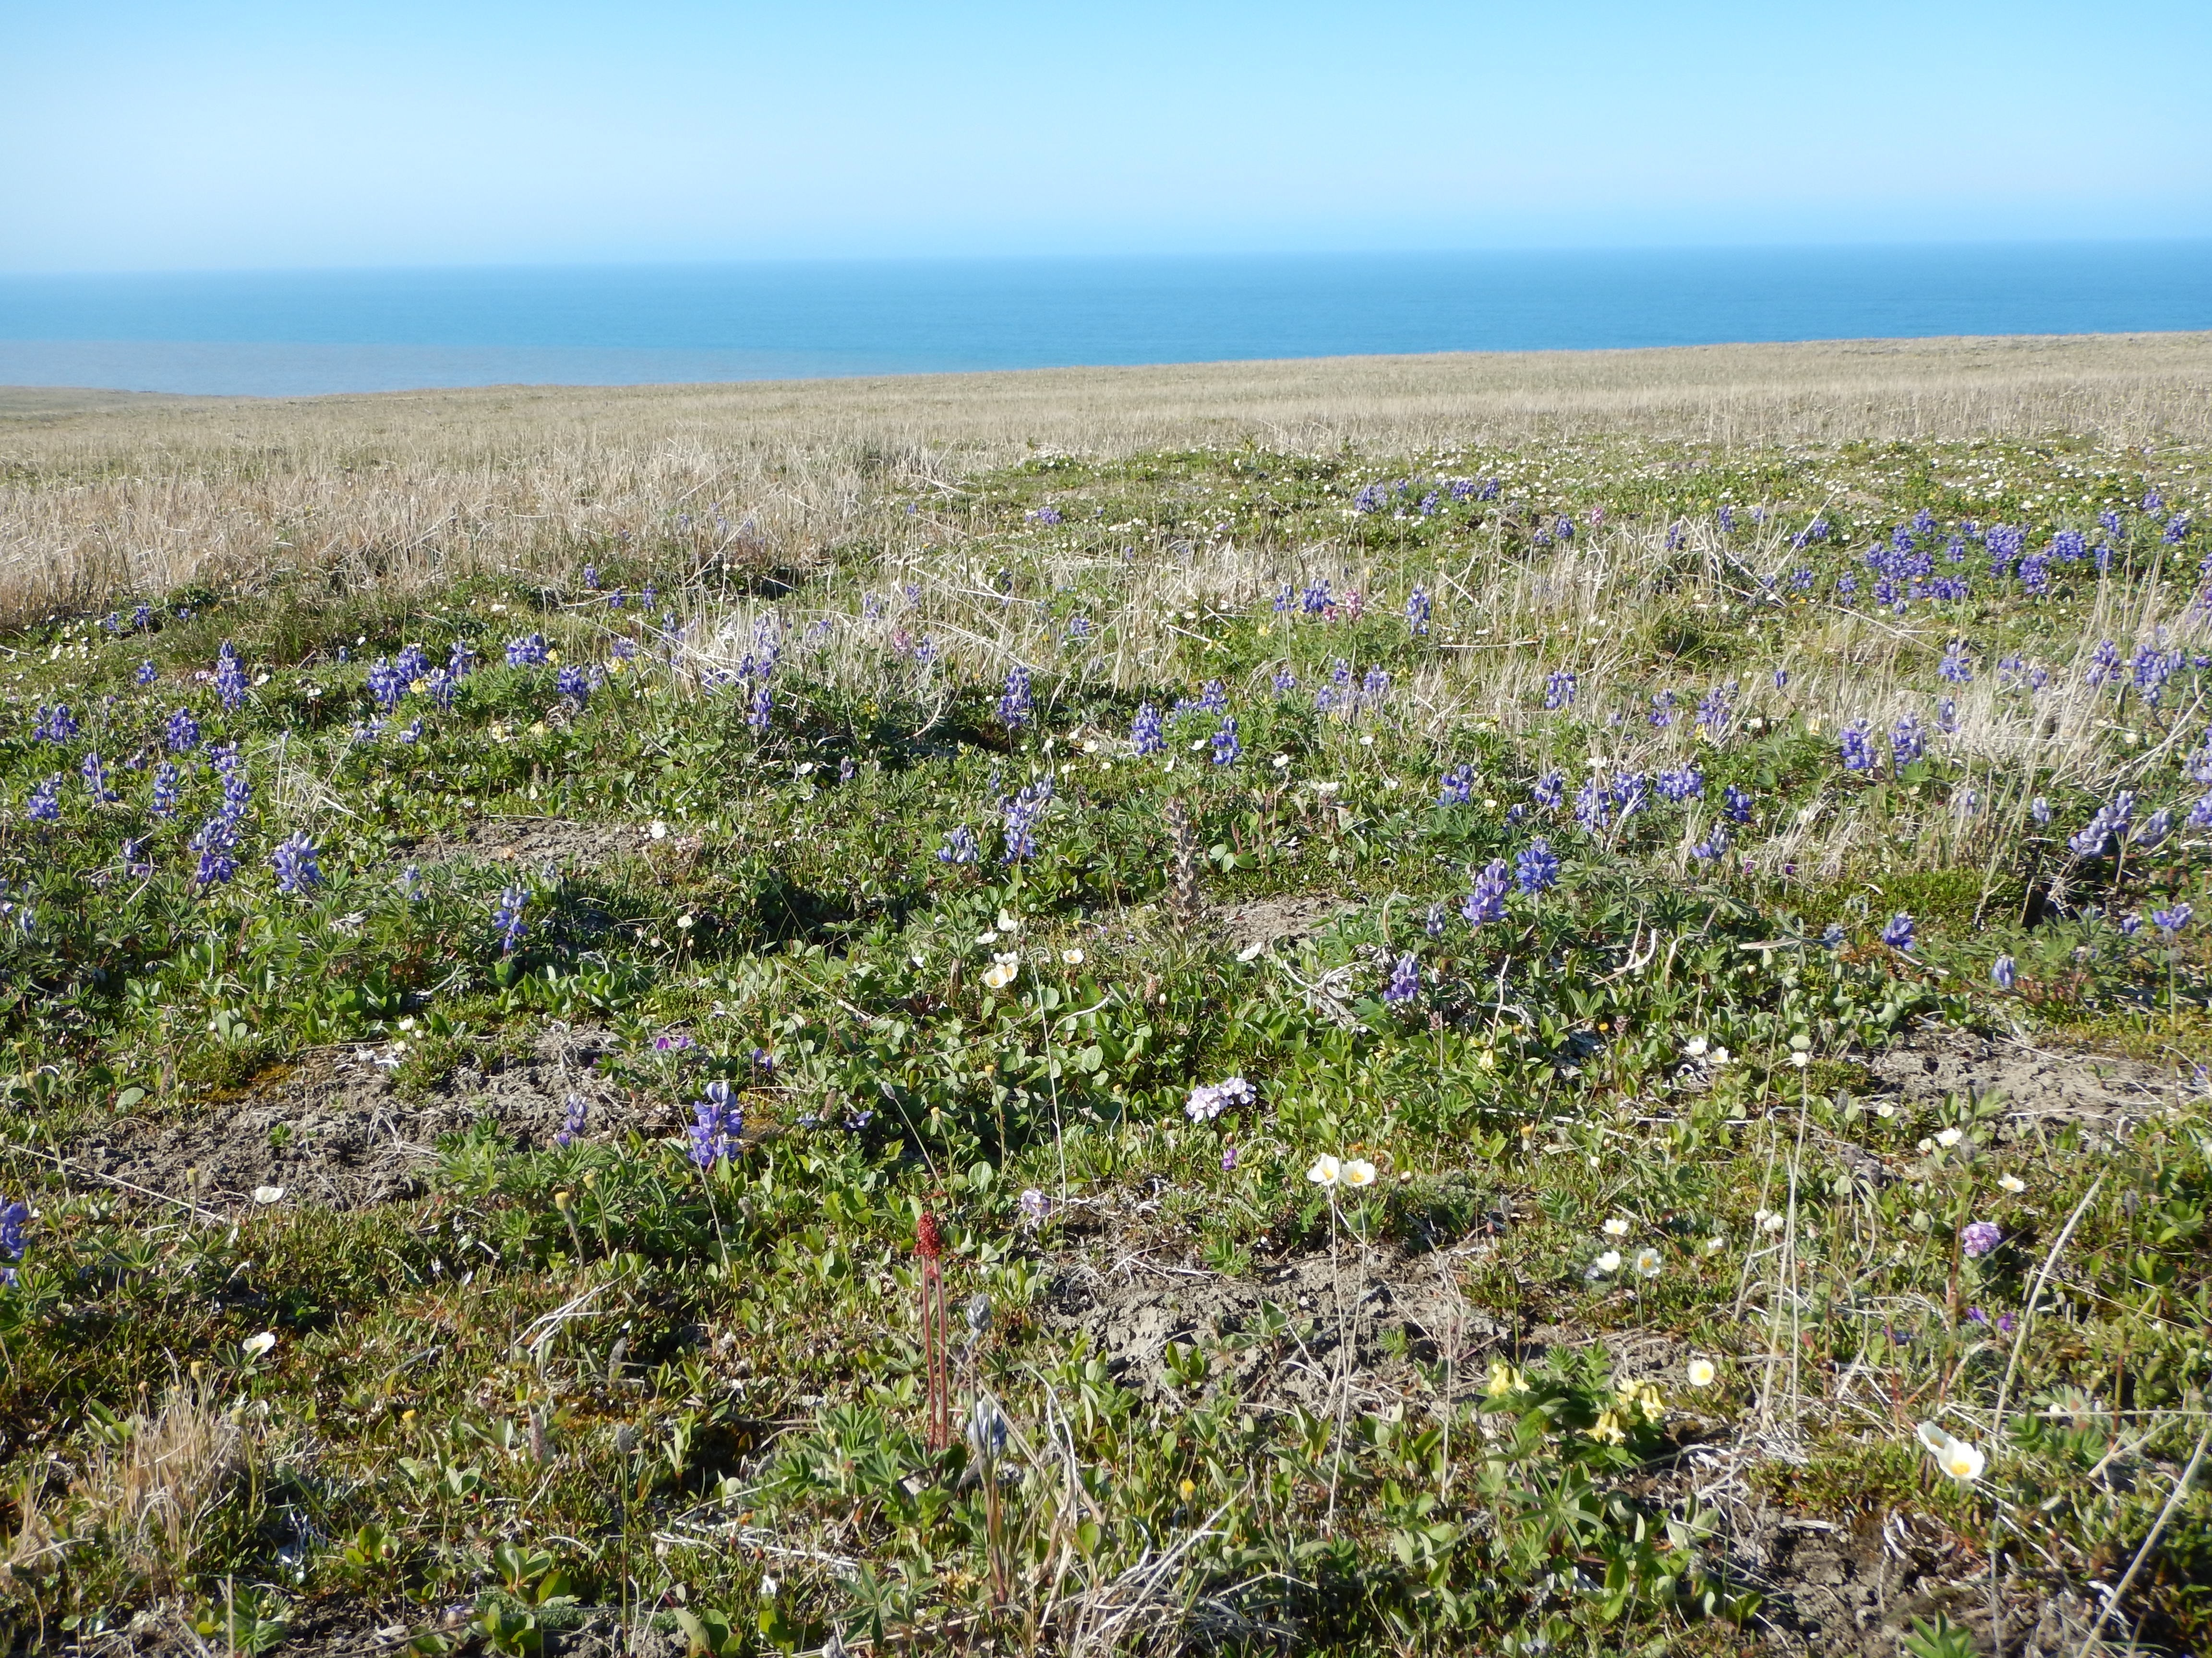
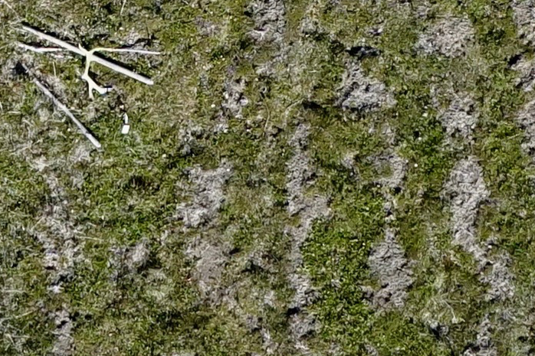
c) Herschel vegetation type
d) Komakuk vegetation type
Photographs by Isla Myers-Smith

